Slide 1
CS 2420: Sorting Algorithms
Dr. Tsung-Wei (TW) Huang
Department of Electrical and Computer Engineering
University of Utah, Salt Lake City, UT

Slide 2
Outline
In this topic, we will introduce sorting, including:
Definitions
Assumptions
In-place sorting
Sorting techniques and strategies
Overview of run times
Lower bound on run times
Define inversions and use this as a measure of unsortedness

Slide 3
Definition
Sorting is the process of:
Taking a list of objects which could be stored in a linear order
(a₀, a₁, ..., a_{n – 1})
e.g., numbers, and returning an reordering
(a'₀, a'₁, ..., a'_{n – 1})
such that
a'₀ ≤ a'₁ ≤ · · · ≤ a'_{n – 1}
The conversion of an Abstract List into an Abstract Sorted List

Slide 4
Definition
In these topics, we will assume that:
Arrays are to be used for both input and output,
We will focus on sorting objects and leave the more general case of sorting records based on one or more fields as an implementation detail

Slide 5
In-place Sorting
Sorting algorithms may be performed in-place, that is, with the allocation of at most Θ(1) additional memory (e.g., fixed number of local variables)
Some definitions of in place as using o(n) memory
Other sorting algorithms require the allocation of second array of equal size
Requires Θ(n) additional memory
We will prefer in-place sorting algorithms

Slide 6
Run-time
The run time of the sorting algorithms we will look at fall into one of three categories:
Θ(n) Θ(n ln(n)) O(n²)
We will examine average- and worst-case scenarios for each algorithm
The run-time may change significantly based on the scenario

Slide 7
Run-time
We will review the more traditional O(n²) sorting algorithms:
Insertion sort, Bubble sort, Selection sort
Some of the faster Θ(n ln(n)) sorting algorithms:
Heap sort, Quicksort, and Merge sort
And linear-time sorting algorithms
Bucket sort and Radix sort
We must make assumptions about the data

Slide 8
Sorting
The most fundamental algorithm in all subjects …
Goal: puts elements in a certain order
Increasing order: 1, 2, 5, 6, 8, 90, 123
Decreasing order: 123, 90, 8, 6, 5, 2, 1
Many algorithm paradigms
Bubble sort
Selection sort
Merge sort
Qsort
…
Today, new sorting algorithms are being invented
Notes:
Then next topic we are going to talk about is sorting. As you can imagine, sorting is the most fundamental algorithm in all computer science and computer engineering subjects. The goal is to put elements in a certain order, often increasing order or decreasing order.
(explain)

Slide 9
Selection Sort
Two loops
Outer loop to repeat n-1 times
Inner loop to find the minimum element
Notes:
Selection sort is one of the simplest methods in the sorting area. The idea is to iteratively scan the sequence of numbers and pick up the number with the minimum or maximum value. That means you will have two loops. The outer loop repeat n-1 times and the inner loop is to find the minimum element.
Intuition is, you need n steps to find the minimum over a sequence of n numbers, right? And how many times do you need in order to make everything sorted.
Explain.

Slide 10
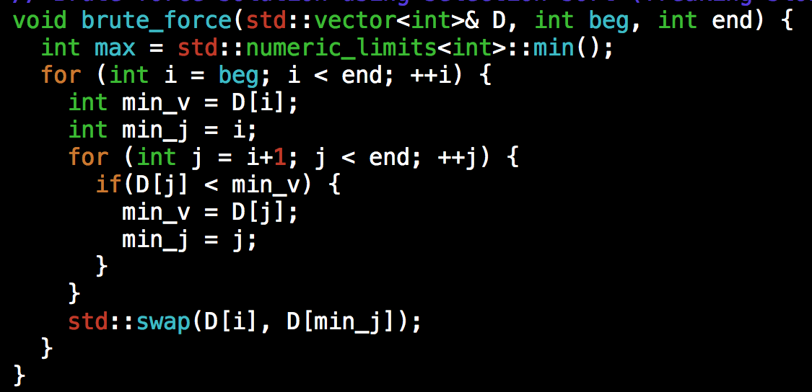
Selection Sort Implementation
Time complexity O(N²)

Slide 11
Using Divide and Conquer: Merge Sort
Divide: If S has at two or more elements (nothing needs to be done if S has zero or one elements), remove all the elements from S and put them into two sequences, S_{L} and S_{R}, each containing about half of the elements of S. (i.e. S_{L} contains the first ⎡n/2⎤ elements and S_{R} contains the remaining ⎣n/2⎦ elements.
Recurse: Recursively sort sequences S_{L} and S_{R}.
Conquer: Put back the elements into S by merging the two sorted sequences S_{L} and S_{R} into a sorted sequence.

Slide 12
Illustration
0
1
2
3
4
5
6
start
20
90
40
30
80
70
50
n = 7
mergesort(a, 0, 6)
1
11
mergesort(a, 0, 3)
mergesort(a, 4, 6)
0
1
2
3
4
5
6
20
90
40
30
80
70
50

Slide 13
Illustration
0
1
2
3
4
5
6
20
90
40
30
80
70
50
2
6
12
16
msort(a, 0, 1)
msort(a, 2, 3)
msort(a, 4, 5)
msort(a, 6, 6)
0
1
2
3
4
5
6
20
90
40
30
80
70
50
3
4
7
8
13
14
0
1
2
3
4
5
20
90
40
30
80
70

Slide 14
Illustration
0
1
2
3
4
5
6
20
90
40
30
80
70
50
5
9
15
0
1
2
3
4
5
20
90
30
40
70
80
10
17
0
1
2
3
4
5
6
20
30
40
90
50
70
80
18
0
1
2
3
4
5
6
20
30
40
50
70
80
90

Slide 15
Merge Sort Complexity
Run Time Analysis
At each level in the binary tree created for Merge Sort, there are n elements, with O(1) time spent at each element
O(n) running time for processing one level
The height of the tree is O(log n)
Therefore, the time complexity is O(nlog n)

Slide 16
Summary
Introduction to sorting, including:
Assumptions
In-place sorting (O(1) additional memory)
Sorting techniques
insertion, exchanging, selection, merging, distribution
Run-time classification: O(n) O(n ln(n)) O(n²)
Overview of proof that a general sorting algorithm must be Ω(n ln(n))
We will have out second Midterm next Week (starting on 11/22)

